Slide 1

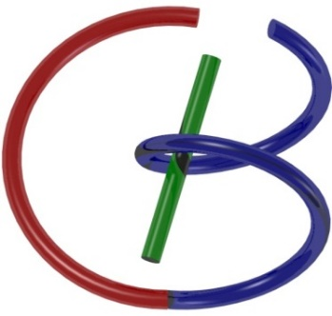
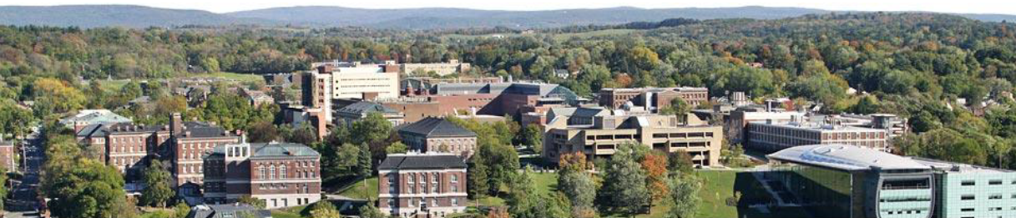
Deep CT Reconstruction
Ge Wang
AI-based X-ray Imaging System (AXIS) Lab
Rensselaer Polytechnic Institute, Troy, New York, USA
Oct. 1, 2021

Slide 2
MI Schedule for F21
Tue | Topic | Fri | Topic
08/31 | Introduction | 09/03 | Neuron, Network & Backpropagation
09/07 | No Class | 09/10 | Hands-on 1: Python, Colab, & TensorF
09/14 | Architectures & Training | 09/19 | Hands-on 2: MNIST Classification
09/21 | Image Quality I | 09/24 | CT Physics
09/28 | CT Reconstruction | 10/01 | Deep CT Reconstruction
10/05 | Hands-on 3: CT Networks | 10/08 | More CT Contents
10/12 | MRI Physics | 10/15 | Spin-Echo
10/19 | K-Space Theorem | 10/22 | More MRI Contents
10/26 | Mid Exam | 10/29 | Deep MRI Reconstruction
11/02 | Hands-on 4: MRI Networks | 11/05 | Nuclear Physics
11/09 | Nuclear Imaging | 11/12 | US Imaging
11/16 | Optical Imaging | 11/19 | Multimodality Imaging
11/23 | Hands-on 5: Image Conversion | 11/26 | Thanksgiving
11/30 | Image Quality II | 12/03 | Stability, Interpretability, & Others
12/07 | Overview | 12/10 | Final Exam
Office Hour: Teaching Day 5-6pm: https://rensselaer.webex.com/meet/wangg6

Slide 3
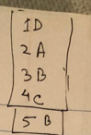
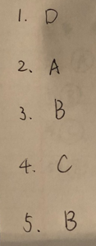
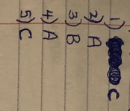
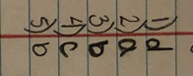
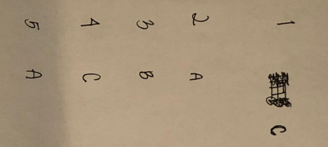
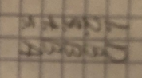
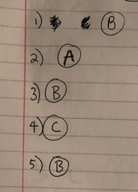
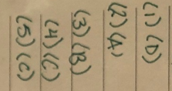
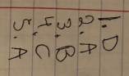
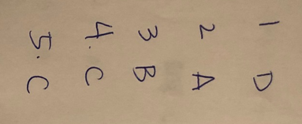
1D 2A 3B 4C 5B

Slide 4
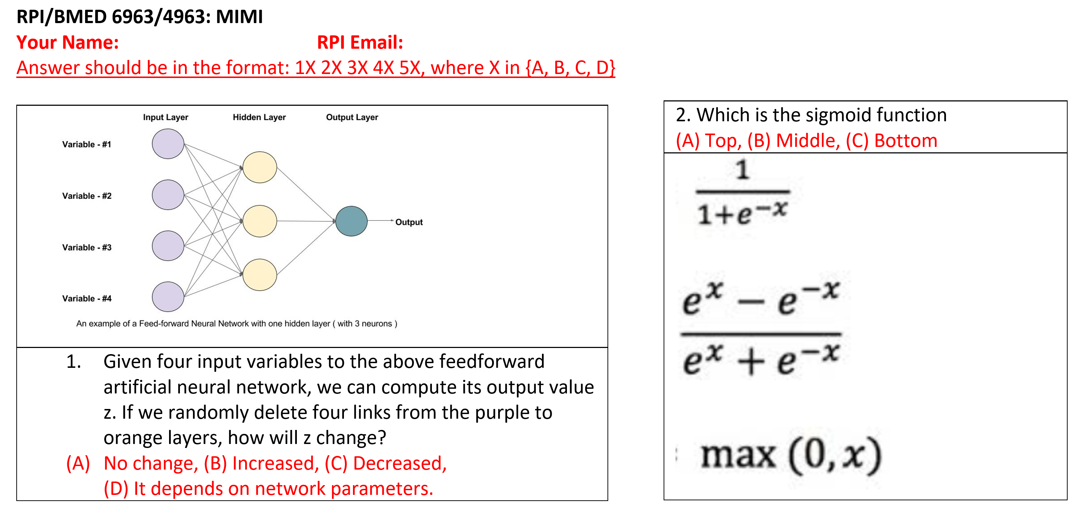

Slide 5
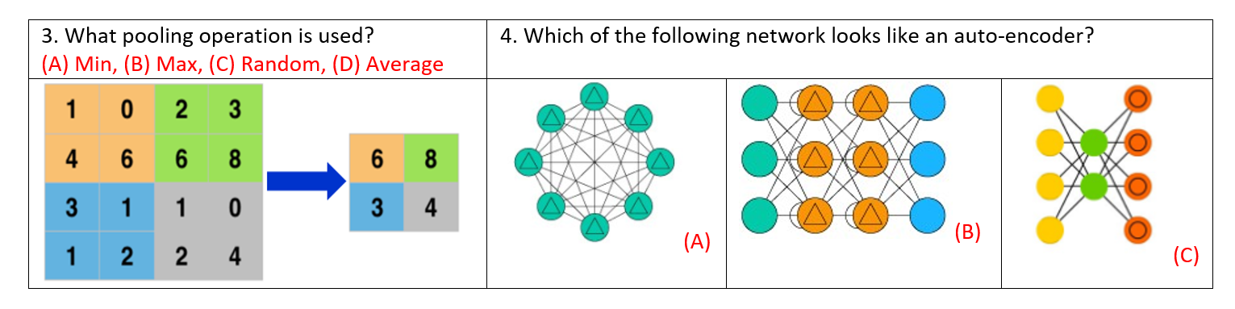

Slide 6
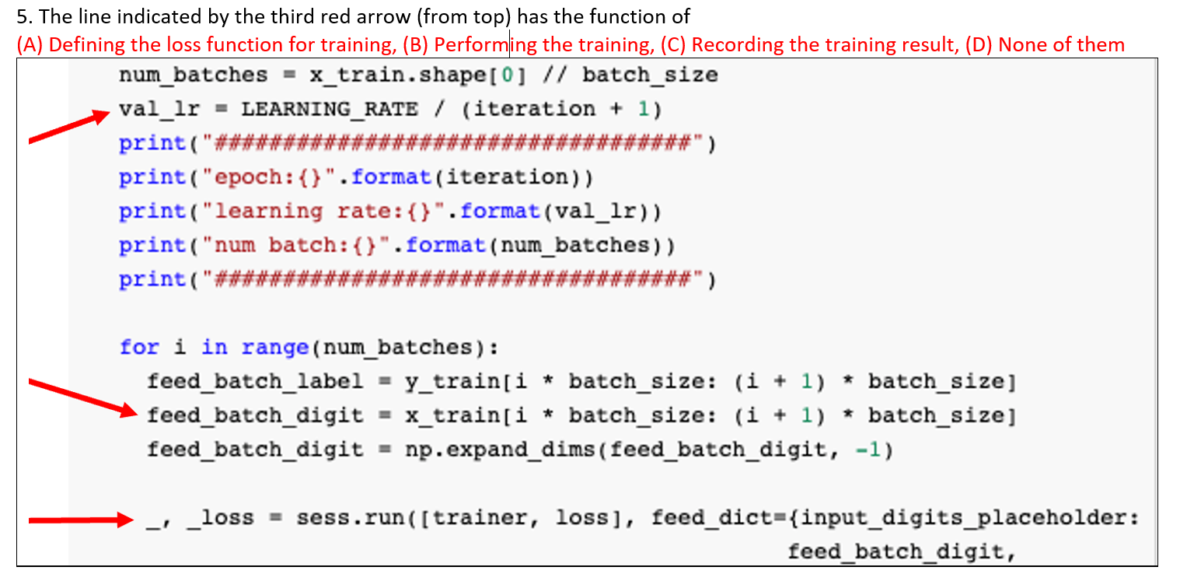

Slide 7

1D Fourier Slice
Radon Transform
1D Fourier Transform
X-rays
2D Fourier Transform

Slide 8
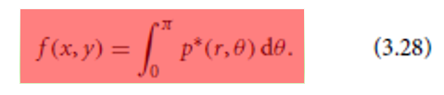
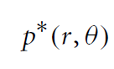
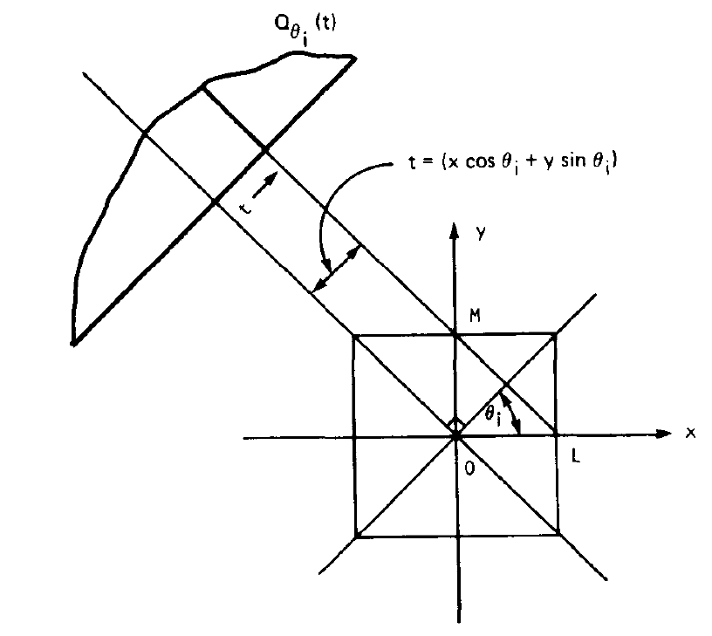

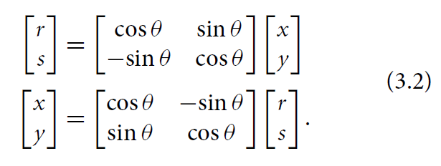
Analytic Viewpoint: Forward vs Backprojection
Projection
r
r
r
r
r

Slide 9
Algebraic Viewpoint: Sum Game
μ₁=4
μ₂=3
μ₃=2
μ₄=1
A practical problem has many more unknowns but the idea is the same!

Slide 10
Algebraic Viewpoint: Trial & Error
6
4
Error
0
0
4
3
3
2
Guess 1
0
0
2
1
3
2
Guess 0
2
4
3
Update a guess based on data differences
Guess 2
−2
2
1
Error

Slide 11
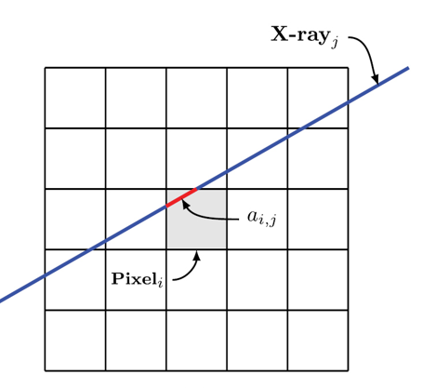
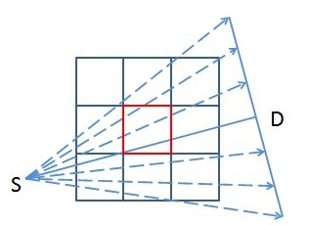
Taking Weights into Account
Pixels contributed to a datum with different weights

Slide 12
Outline
Transposed Operation
Deep Denoising
Deep Reconstruction

Slide 13
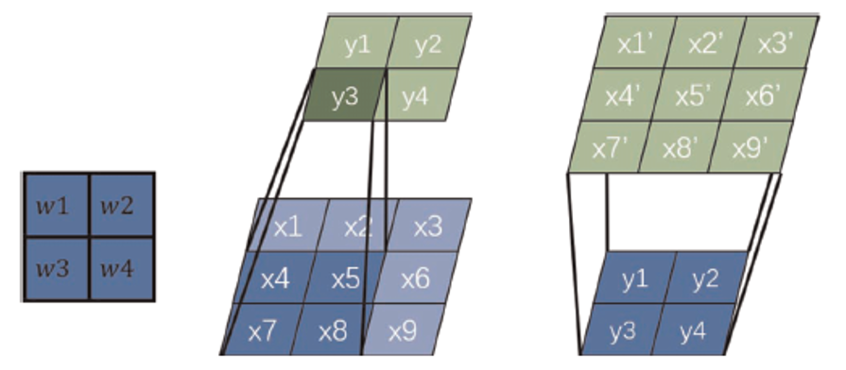
Convolution vs Deconv. (Transposed Conv.)
For a convolution kernel (Left), convolution (Middle) is used to down-sample an image or a feature map from a large to small matrix, and transposed convolution (Right) is used to up-sample an image or a map from a small to large matrix.

Slide 14
Generalized: Matrix A & Its Transpose A^{T}
Ax=y
A: m x n (2 x 3)
x: n x1 (3 x 1)
A^{T}y’=x’
A^{T}: n x m (3 x 2)
y’: m x 1 (2 x 1)
x in R³
y in R²
x’ in R³
y’ in R²

Slide 15
Backprojection Needed in FBP & Iteration
Projection
r
r
r
r
r

Slide 16
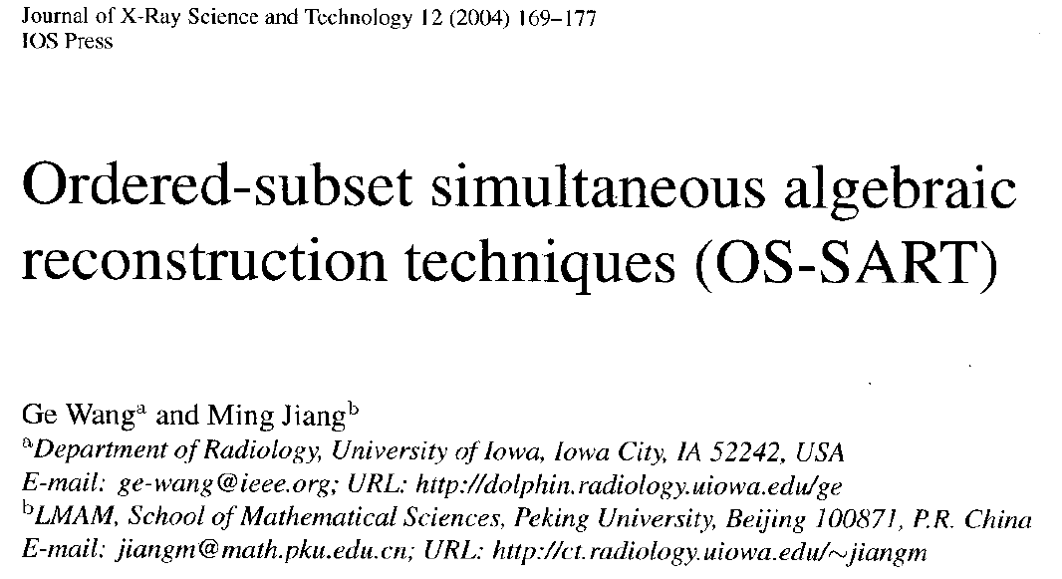
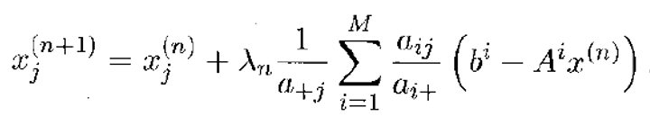
Heuristically-derived SART Formula
Relative Contribution Weight
Error
Relative Rectifying Factor

Slide 17
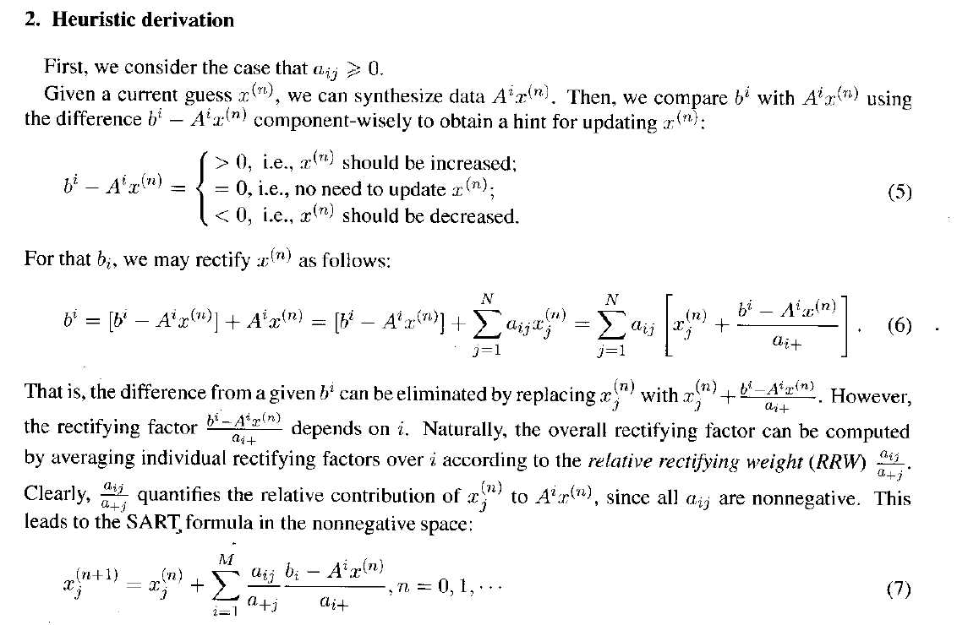

Slide 18
Weighted Contributions
Pixels contributed to a datum with different weights
Error correction-based updates should use the same weights

Slide 19
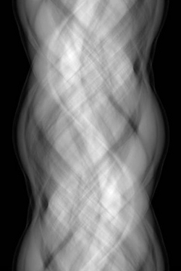
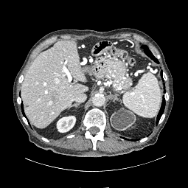
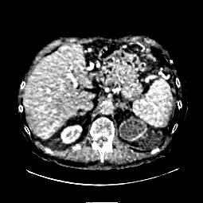
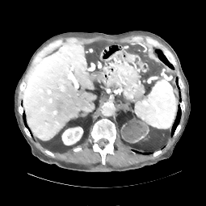
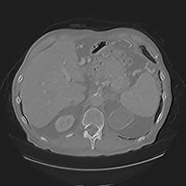
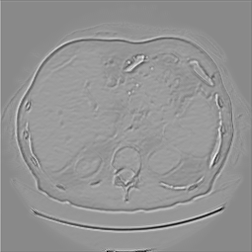
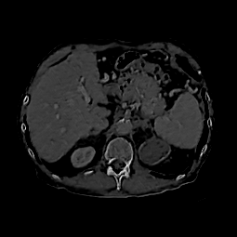
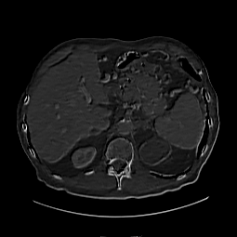
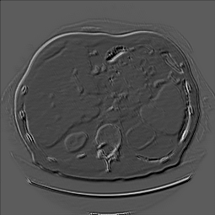
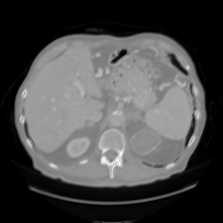
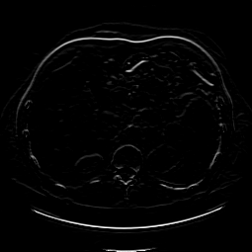
Reconstruction from Sparse Data
Under-sampled Data
Reconstruction
…
…
1st
2nd
t-th
(T-1)-th
T-th
Iteration-inspired Layer
Conv+ReLU
Conv
Chen H, Zhang Y, Chen YJ, Zhang WH, Sun HQ, Lv Y, Liao PX, Zhou JL, Wang G:
LEARN: Learned Experts’ Assessment-based Reconstruction Network for Sparse-data CT. IEEE Trans. Medical Imaging, June 2018

Slide 20
Outline
Transposed Operation
Deep Denoising
Deep Reconstruction

Slide 21
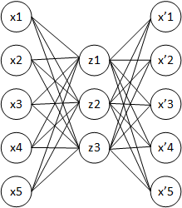

Auto-encoder
This is one of the greatest ideas in deep learning. If you explore more, you can create more advanced networks!

Slide 22
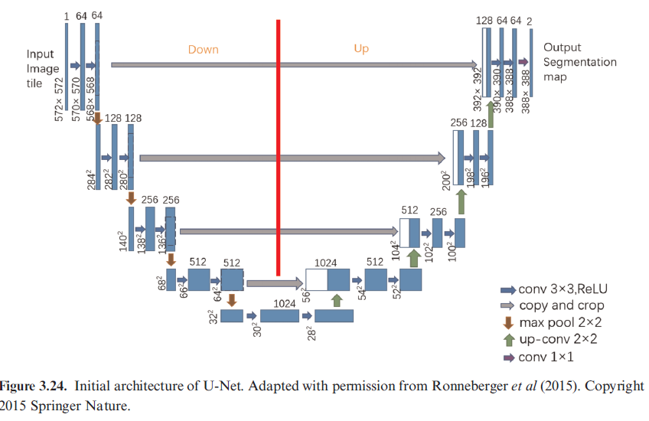
U-Net for Denoising & More

Slide 23
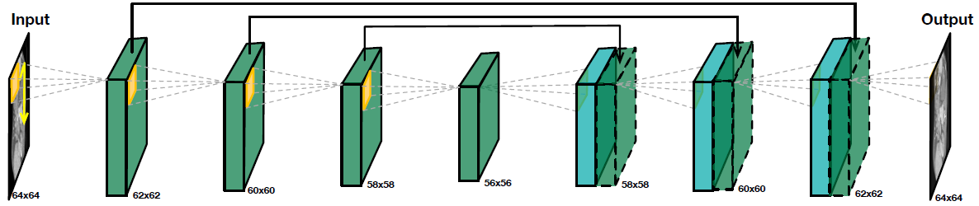
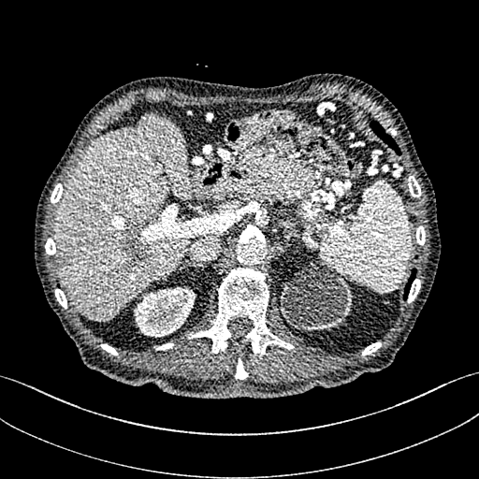
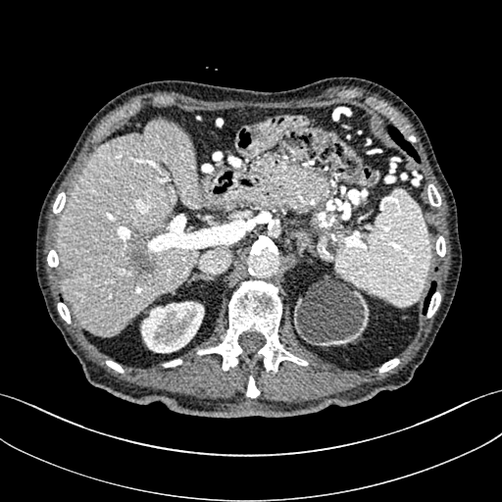

Low-dose CT Denoising: FBP + Network
CT Denoising Neural Network by RPI,
Sichuan University, & Harvard University
Low-quality CT Scan
(1/4 Radiation Dose)
High-quality CT Scan
(Standard Radiation Dose)
Machine Learning Turns Low-quality CT Image into High-quality Counterpart
IEEE Trans. Medical Imaging 37:1522-1534, 2018 (https://ieeexplore.ieee.org/stamp/stamp.jsp?arnumber=8353466)

Slide 24
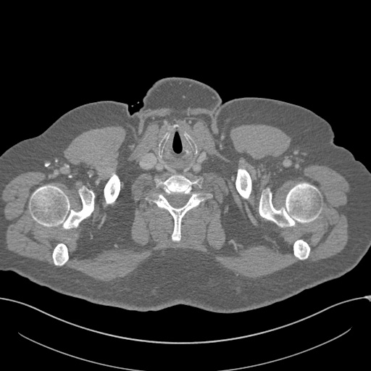
Image Preprocessing
64*64 patches were extracted with strides 32
Image pixel values were made in [-300, 300] HU (just think HU as some unit)

Slide 25
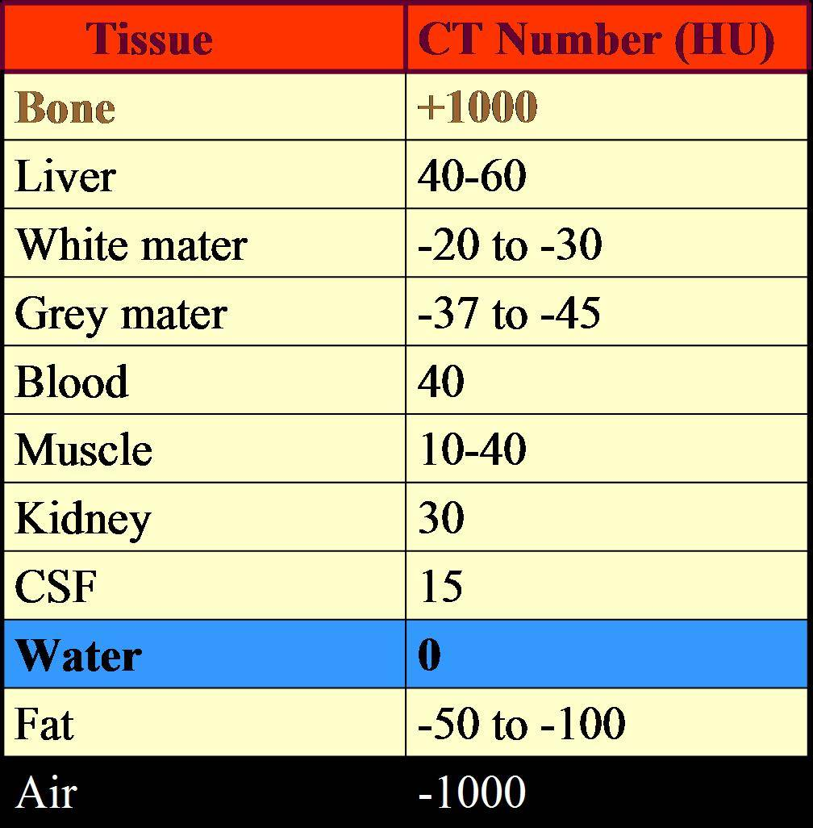
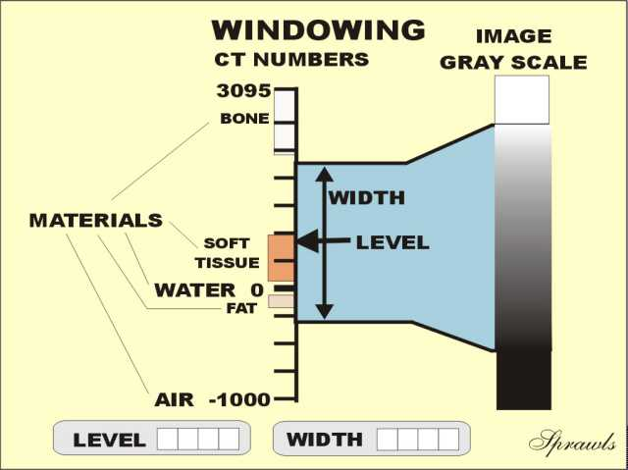

CT Number (HU)
CT Image Quantized to CT Number in Hounsfield Unit:
$${CT}_{number}=\frac{μ−μ_{water}}{μ_{water}}×1000$$

Slide 26
Examples & Idea (16 Bits?)
The Range of CT Number in Hounsfield Unit: -1K – ~3K
12 Bits: 4,096 Levels
16 Bits: 65,536 Levels
AI / Deep Learning Will Do Better with 16 Bits (I think)

Slide 27
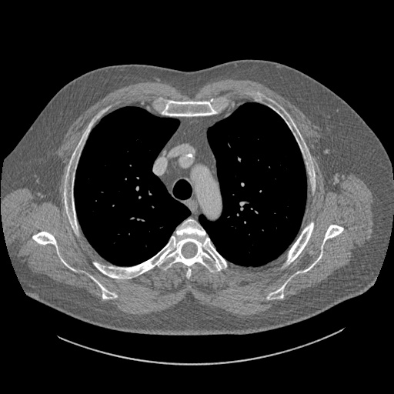


Deep Denoising Results
Full-dose Recon
AI Denoising
Low-dose Recon

Slide 28
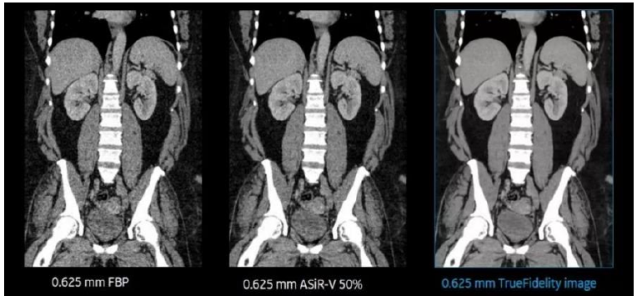
GE Medical CT Denoising (RSNA’18)

Slide 29
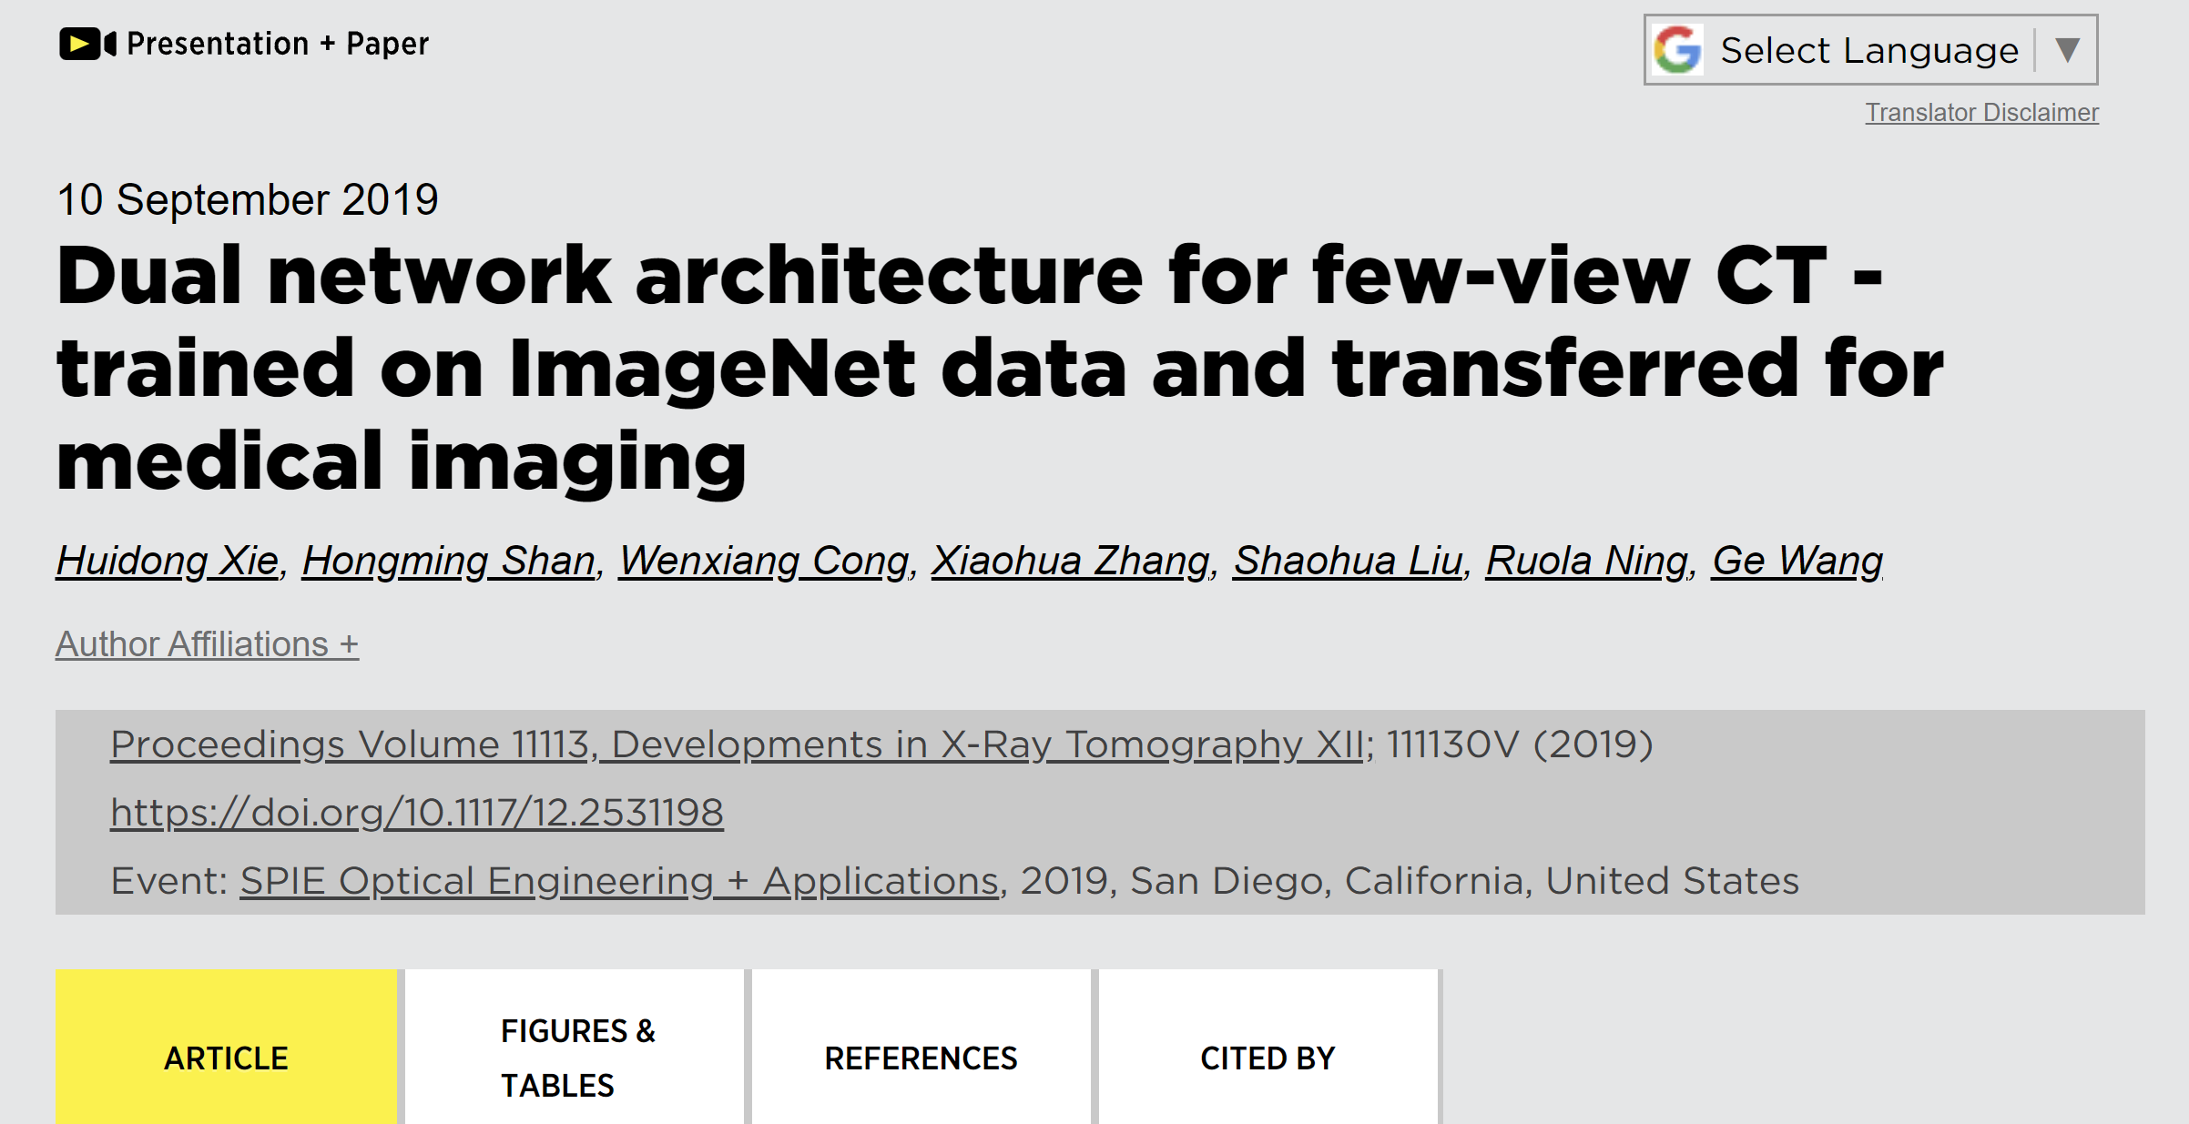

Slide 30
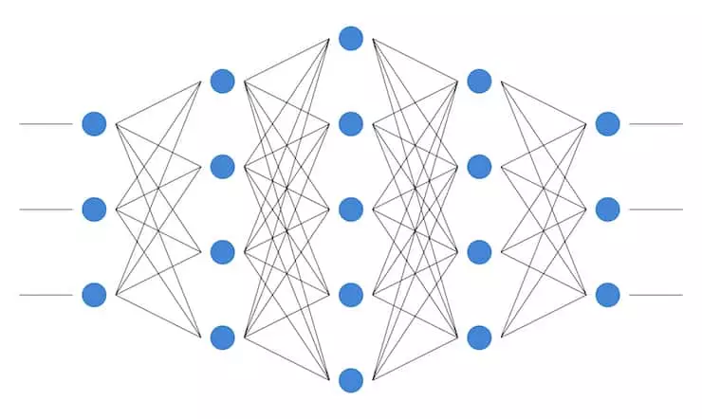
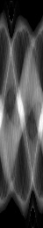
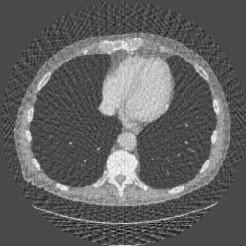

Few-view CT
Few-view Sinogram
Intermediate FBP Image
FBPConvNet
Reconstructed Image
Jin KH, McCann MT, Froustey E, Unser M: Deep Convolutional Neural Network for Inverse Problems in Imaging. IEEE Transactions on Image Processing 26(9):4509–4522, 2017
Notes:
Few-view CT is a main approach for low-dose CT. Because of the requirements imposed by the Nyquist sampling theorem, reconstructing high-quality images from under-sampled projection data was consider impossible. And deep neural networks demonstrates its potential to eliminate artifacts introduced by insufficient projection data. In most previous few-view CT deep-learning methods, few-view images are used as the input to the neural network, such as the FBPConvNet. The network structure is a classic encoder-decoder network with conveying paths. But directly using FBP-reconstructed images as input may loss information embedded in the projection data, resulting in incorrect reconstruction. In this talk, our proposed dual network architecture (DNA) tries to learning the reconstruction process directly from raw projection data.

Slide 31
Outline
Transposed Operation
Deep Denoising
Deep Reconstruction

Slide 32
CT Fourier Slide Theorem
Radon Transform
1D Fourier Transform
X-rays
2D Fourier Transform

Slide 33


MRI k-Space Theorem

Slide 34
Sparse-data CT De-artifacts: “LEARN”
Under-sampled Data
Reconstruction
…
…
1st
2nd
t-th
(T-1)-th
T-th
Iteration-inspired Layer
Conv+ReLU
Conv
Chen H, Zhang Y, Chen YJ, Zhang WH, Sun HQ, Lv Y, Liao PX, Zhou JL, Wang G:
LEARN: Learned Experts’ Assessment-based Reconstruction Network for Sparse-data CT. IEEE Trans. Medical Imaging, June 2018

Slide 35




AUTOMAP with $O\left(N^{4}\right)$ Complexity
$O\left(N^{3}×N_{v}\right)$ Complexity
$N:$# of Data or Pixels per Row
$N_{v}:$# of views
Reshape
To a Vector
$$3×3$$
k-space Data
FC Layers to All Pixels
$3×3$ Image
Zhu B, Liu JZ, Cauley SF, Rosen BR, Rosen MS: Image reconstruction by domain-transform manifold learning. Nature 555:487–492, 2018
Notes:
In the literature, only a few deep-learning methods were proposed for reconstructing medical images directly from raw data. AUTOMAP, published last year on Nature, is the first work trying to learn the reconstruction process. N denotes the dimension of reconstructed image. AUTOMAP use 3 fully-connected layers to the the mapping between raw k-space data to a corresponding MRI images. The basic idea of AUTOMAP could be illustrated here. Due to the intrinsic relation between frequency domain and time domain, every pixel in k-space domain is related every pixel in image domain. Fully-connected layer is able to learn this relation. Without a doubt, similar idea could be applied to CT since sinograms and images are also correlated. If we directly apply AUTOMAP for CT applications, the complexity would be $O\left(N^{3}×N_{v}\right)$. N_v donotes the number of view. There are two problems if we use AUTOMAP for CT: 1. Due to the large computational complexity, AUTOMAP is not able to train normal size CT images on modern GPUs. In the AUTOMAP paper, authors used 128*128 images. 2. FC layers imply that all the pixels in both domain are correlated, but this is not the true for CT. In CT imaging, x-ray are used to take line integral at various angle, so a single point in the sinogram only relate to a line in the field of view.

Slide 36

iCT Network
Li, Yinsheng & li, ke & Zhang, Chengzhu & C. Montoya, Juan & Chen, Guang-Hong. (2019). Learning to Reconstruct Computed Tomography (CT) Images Directly from Sinogram Data under A Variety of Data Acquisition Conditions. IEEE Transactions on Medical Imaging. PP. 10.1109/TMI.2019.2910760.

Slide 37
iCTNet with $O\left(N^{2}×N_{c}\right)$ Complexity
FC
$3×3$ image
FC
$3×3$ final output
$4×3$ sinogram
$4α×3$ sinogram
$3×3$ image
*Li, Y., Li, K., Zhang, C., Montoya, J. and Chen, G., “Learning to Reconstruct Computed Tomography (CT) Images Directly from Sinogram Data under A Variety of Data Acquisition Conditions,” IEEE Transactions on Medical Imaging, 1–1 (2019).
Notes:
The second work trying to learn the reconstruction process is the iCTNet published on IEEE transaction on medical imaging this year. N_c denotes the number of detectors. The overall idea of iCTNet can be summarized here. Assume a CT scanner with 3 detectors and 4-view sinogram is acquired. iCTNet contains a total of 12 layers, in the first 8 layers, convolutional layers are used to de-noised sinogram, and to learn the interpolation process, generating a learned full-view sinogram with number of view $4α$, where$α$ is a hyperparameter in iCTNet. Then, instead of feeding the whole sinogram into one large FC layer, iCTNet feeds projection at each angle in to a small FC layer, thereby reducing the computation burden. Rotation operations are used to synthesis the analytical FBP method and then one convolutional layer is used to combine all the images at different angle, generating final output.

Slide 38



Slide 39
Our Key Idea: Smart BP with $O\left(N2\right)$ Complexity
Learned Filtered Projection
Smart Backpropagation with Learned Weights Restricted to a Single X-ray Path

Slide 40

Our Key Idea: Smart BP with $O\left(N\right)$ Complexity
Learned Filtered Projection
Smart Backpropagation with Learned Weights Restricted to a Single X-ray Path
Notes:
Our method is able to learn the reconstruction process as low as O(N) parameters. As illustrated here, blue boxes represent a 3*3 CT image, and 2 projections are acquired at the angles shown here. Yellow dots represent points in the acquired projections. AUTOMAP assumes that these 6 dots are related to all 9 pixels. iCTNet assumes that projection at a particular angle only relates to the back-projected image at this angle. Our method, DNA assumes that every single dot only relates to a single line in the field of view. Which is true for CT scans. And the analytical FBP method also has this assumption. In order words, our method learn the reconstruction process in a point-wise manner. Instead of trying to learn the whole reconstructed image using one large FC layer, proposed method takes a single point as input and tries to learn a single line in the field of view.

Slide 41


Results
Full View Recon
AI Recon
FBP Recon
More training time is needed for better results

Slide 42

U-net Helps (Combine for Denoising)
Full View Recon
AI Recon
FBP Recon

Slide 43
Homework
Read papers #4-6 to understand what I explained in the class on iterative and deep reconstruction
Watch the hands-on3 video, do hands-on 3 assignments, and report your experience in deep denoising and deep reconstruction (Network principle, training & testing time, error analysis)

